Slide 1

The magic behind your Lyft ride prices
A case study on machine learning and streaming
Strata Data, San Francisco, March 27th 2019
Rakesh Kumar | Engineer, Pricing
Thomas Weise | @thweise | Engineer, Streaming Platform
go.lyft.com/dynamic-pricing-strata-sf-2019
Notes:
introduce self
https://conferences.oreilly.com/strata/strata-ca/public/schedule/detail/72805

Slide 2
Agenda
Introduction to dynamic pricing
Legacy pricing infrastructure
Streaming use case
Streaming based infrastructure
Beam & multiple languages
Beam Flink runner
Lessons learned

Slide 3

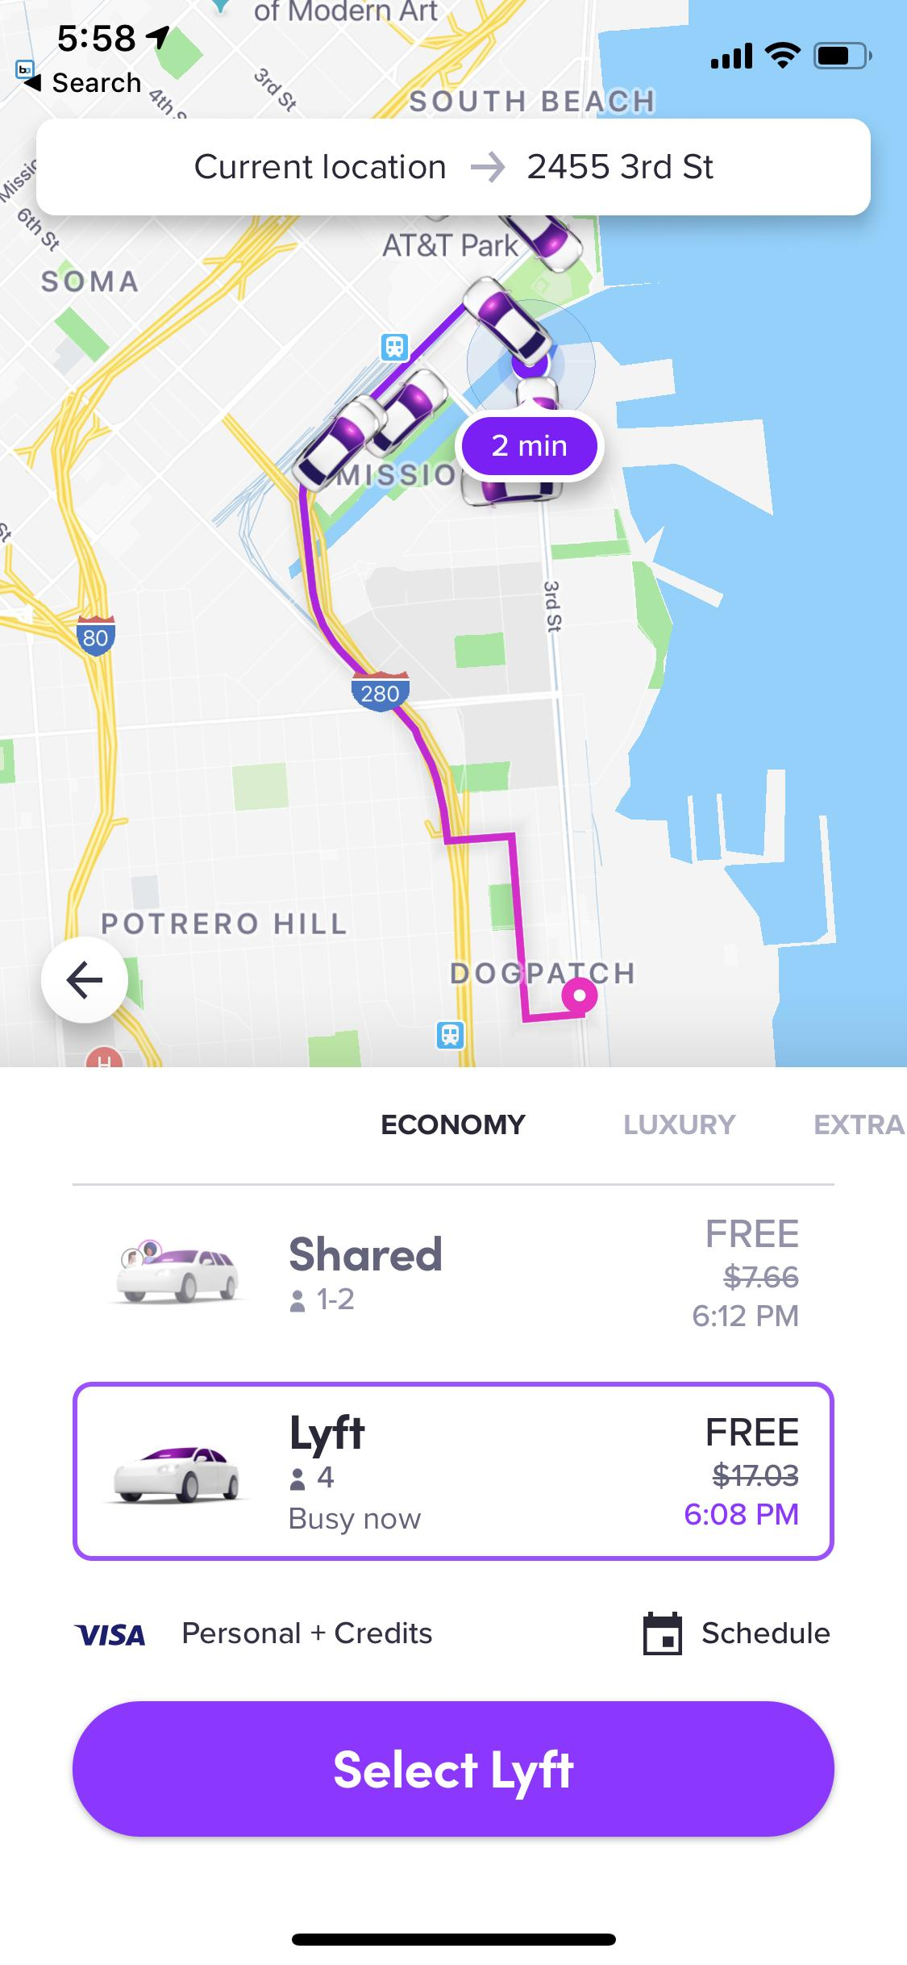
Pricing
Core Experience
Dynamic Pricing
Supply/Demand curve
ETA
Top Destinations
User Delight
Fraud
Notifications
Detect Delays
Coupons
Behaviour Fingerprinting
Monetary Impact
Imperative to act fast
Notes:
Lyft is a ride sharing company, our goal is to match passengers with drivers. Our goal is to ensure our users - both drivers and passengers are happy. This means short ETA, fair pricing, fair earnings for drivers and timely notifications.
To achieve these a lot of decisions are made in realtime. For example, to ensure fair pricing and fair pay, supply/demand curves are taken into account. This changes with traffic and other conditions so it is imperative our models adapt to that in realtime.
We want to make sure our users are getting notified in a timely manner about delays, route changes, coupons etc.
We also want to combat Fraud on the platform, since there can be severe monetary impact. For example: we look at anomalies in user behaviour, for example if a user enters several different credit cards one after another thats a red flag. And once again it is important to detect these patterns as quickly as possible.

Slide 4
Introduction to Dynamic Pricing

Slide 5
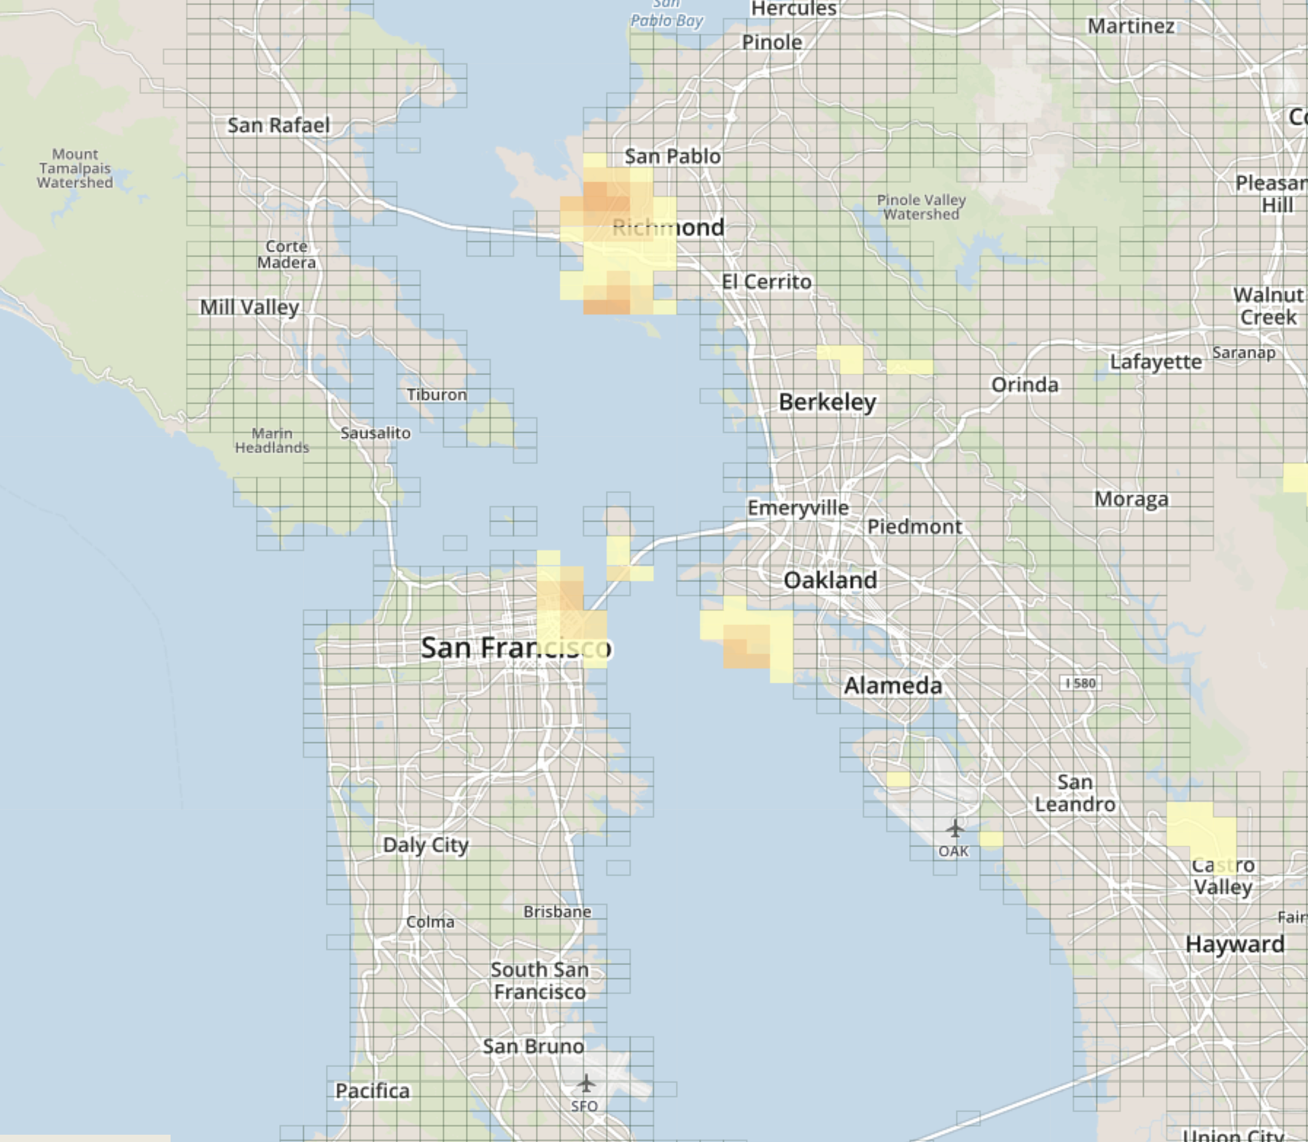
What is prime time?
Location + time specific multiplier on the base fare for a ride
e.g. "in downtown SF at 5:00pm, prime time is 2.0"
Means we double the normal fare in that place at that time
Location: geohash6 (e.g. ‘9q8yyq’)
Time: calendar minute
Notes:
"A geohash is a convenient way of expressing a location (anywhere in the world) using a short alphanumeric string, with greater precision obtained with longer strings."
gh6 (our level of precision for PT) is a couple of city blocks
models run on order of # of geohashes square, region can have as much as 10000 geohashes, pairs of geohashes are compared, 300 regions

Slide 6


Why do we need prime time?
Balance supply and demand to maintain service level
State of marketplace is constantly changing
"Surge pricing solves the wild goose chase" (paper)
Notes:
Some people assume it's a way for us to make money but it's not... we would prefer not to have to do it.
But we have to in order to balance supply and demand
example-- bad weather or concert gets out, suddenly we have lots of people requesting and not enough drivers
if we don't PT all drivers will quickly be used up and waits for rides will increase unacceptably;
also more and more drivers will spend their time en route to pick up passengers rather than giving rides to passengers (utilization goes down)
“surge” pricing only at high demand times, brings demand back under control and avoids these catastrophic failures.
https://papers.ssrn.com/sol3/papers.cfm?abstract_id=2890666
"optimum level of throughput maximizing demand" is what we're trying to find
Abstract
Ride-hailing apps usually match more efficiently than taxis, but they can enter a failure mode anticipated by Arnott (1996) that we call wild goose chases. High demand depletes the platform of idle drivers, so cars must be sent to pick up distant customers. Time wasted on pick-ups decreases drivers’ earnings, leading to exit and exacerbating the problem. Raising prices, either by keeping them consistently high or “surge” pricing only at high demand times, brings demand back under control and avoids these catastrophic failures. Banning surge pricing would thus likely result in always-high prices. Alternative solutions would undermine ride-hailing’s brand promise.

Slide 7
Legacy Pricing Infrastructure

Slide 8
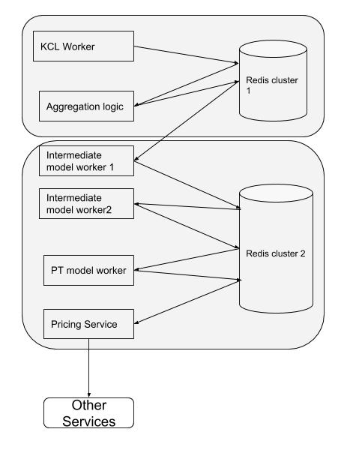
Legacy architecture: A series of cron jobs
Ingest high volume of client app events (Kinesis, KCL)
Compute features (e.g. demand, conversation rate, supply) from events
Run ML models on features to compute primetime for all regions (per min, per gh6)
SFO, calendar_min_1: {gh6: 1.0, gh6: 2.0, ...}
NYC: calendar_min_1: {gh6, 2.0, gh6: 1.0, ...}
Notes:
gigantic optimization problem to find PT that gives "optimum level of throughput maximizing demand" subject to constraints. talk about inputs? (how many drivers do we need to hold in reserve to maintain some level of eta, what effect does PT have on conversions, what level of conversions are we seeing, what level of demand are we seeing...) And also intricacies like mode specific PT
So that's what PT is. How do we calculate it? At a high level-- we ingest client events (app opens, ride requests, etc) that come in constantly at high volume. We process these events to generate features that are input to machine learning models that output the necessary PT to achieve our desired ETA/driver reserve levels (or whatever objective we decide upon),
At each stage, essentially we have a bunch of worker machines running cron jobs. We distribute work across workers using a 'region' abstraction -- i.e. San Francisco, New York. We use redis to store intermediate results and to handle region-level locks so two workers don't try to process the same region.
region-level distribution of work, with the help of redis lock.
Requirements:
1. Low latency, high reliability, scalability -- We need to process all events per min and respond quickly to changes in market... market conditions can change quickly (e.g. weather). Crucial to business. We're growing by leaps and bounds so our event volume is growing accordingly
2. Allow quick iteration to support new ML models and features -- our data scientists are constantly cooking up new models and we need to be able to implement them with minimal hassle
~100 features per geohash, ~3 million geohashes total, per minute = ~400 billion features per day

Slide 9
Problems
Latency
Code complexity (LOC)
Hard to add new features involving windowing/join (i.e. arbitrary demand windows, subregional computation)
No dynamic / smart triggers
Notes:
Latency--
because our dag runs as a series of cron jobs (every minute, not continual), and at each stage worker can only proceed if it has all inputs, we end up having responsiveness suffer... can be as much as several mins between when events are observed and when they are reflected in pt output
Hard to see DAG structure and any aggregation changes have to be handcoded; windowing etc is done through complex redis keying. we can only trigger on processing time

Slide 10
Can we use Flink?

Slide 11








Streaming Stack
Source
Sink
Streaming
Application
(SQL, Java)
Stream / Schema
Registry
Deployment
Tooling
Metrics & Dashboards
Alerts
Logging
Amazon
EC2
Amazon S3
Wavefront
Salt
(Config / Orca)
Docker
‹#›

Slide 12
Streaming and Python
Flink and many other big data ecosystem projects are Java / JVM based
Team wants to adopt streaming, but doesn’t have the Java skills
Jython != Python
Use cases for different language environments
Python primary option for Machine Learning
Cost of many API styles and runtime environments

Slide 13

Solution with Beam
Source
Sink
Streaming
Application
(Python/Beam)

Slide 14
Streaming based Pricing Infrastructure
Notes:
Solution: Streaming!

Slide 15
Pipeline (conceptual outline)
Lyft apps (phones)
kinesis events (source)
filter events
aggregate and window
run models to generate features (culminating in PT)
ride_requested, app_open, ...
valid sessions, dedupe, ...
unique_users_per_min,
unique_requests_per_5_min, ...
conversion learner,
eta learner, ...
internal services
redis
Notes:
The new pipeline at a high level

Slide 16
Details of implementation
Filtering (with internal service calls)
Aggregation with Beam windowing: 1min, 5min (by event time)
Triggers: watermark or stateful processing
Machine learning models invoked using stateful Beam transforms
Final gh6:pt output from pipeline stored to Redis
Notes:
We use watermarks to trigger computation; watermark is an estimate of when we have seen all events up to a given event time. It let us know we are 'done' ingesting events that time and can proceed with computations for the corresponding time window. Watermark estimate is across all regions so we also track completed inputs per region (via stateful processing) and trigger a region early if its inputs are available.
stateful processing
Currently 120 taskmanager instances, still tweaking task slots per instance, network buffer and other variables. M5.4xlarge (16 vCPU, 64 GB) machines running in AWS. eventually will move to k8s.

Slide 17
Gains
60% reduction in latency
Reuse of model code
10K => 4K LOC
300 => 120 AWS instances
Notes:
We decreased latency by 60% so the system is more reactive and calculating primetime way before the legacy system. This makes the system more reactive and balances the marketplace sooner.

Slide 18
Beam and multiple languages
Notes:
Solution: Streaming!

Slide 19
The Beam Vision
Beam Java
Other
Languages
Beam Python
End users: who want to write pipelines in a language that’s familiar.
SDK writers: who want to make Beam concepts available in new languages. Includes IOs: connectors to data stores.
Runner writers: who have a distributed processing environment and want to support Beam pipelines
Beam Model: Pipeline Construction
Apache Flink
Cloud Dataflow
Apache Spark
Beam Model: Fn Runners
Execution
Execution
Execution
https://s.apache.org/apache-beam-project-overview
Notes:
Our goal in Beam is to fully support three different categories of users
End users who are just interested in writing data processing pipelines. They want to use the language that they want to use and choose the runtime that works for them, whether it’s on premise, on a hand tuned cloud cluster, or on a fully managed service.
In addition, we want to develop stable APIs and documentation to allow others in the open source community to create Beam SDKs in other languages and to provide runners for alternate distributed processing environments.

Slide 20



Multi-Language Support
Initially Java SDK and Java Runners
2016: Start of cross-language support effort
2017: Python SDK on Dataflow
2018: Go SDK (for portable runners)
2018: Python on Flink MVP
Next: Cross-language pipelines, more portable runners

Slide 21
Python Example
p = beam.Pipeline(runner=runner, options=pipeline_options)
(p
| ReadFromText("/path/to/text*") | Map(lambda line: ...)
| WindowInto(FixedWindows(120)
trigger=AfterWatermark( early=AfterProcessingTime(60),
late=AfterCount(1)) accumulation_mode=ACCUMULATING)
| CombinePerKey(sum))
| WriteToText("/path/to/outputs")
)
result = p.run()
( What, Where, When, How )

Slide 22






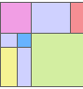

Portability (originally)
Apache Flink
Java
Apache Spark
input.apply(
Sum.integersPerKey())
Java objects
Apache Apex
Sum Per Key
SQL (via Java)
Gearpump
SELECT key, SUM(value) FROM input GROUP BY key
IBM Streams
⋮
Apache Samza
Apache Nemo (incubating)
Python
⋮
Dataflow JSON API
input | Sum.PerKey()
Sum Per Key
Cloud Dataflow
https://s.apache.org/state-of-beam-sfo-2018

Slide 23
Portability (current)
Apache Apex
Java
Apache Spark
Java objects
input.apply(
Sum.integersPerKey())
Sum Per Key
Gearpump
IBM Streams
SQL (via Java)
SELECT key, SUM(value) FROM input GROUP BY key
Apache Nemo (incubating)
⋮
Python
Portable protos
input | Sum.PerKey()
Sum Per Key
Apache Samza
Go
stats.Sum(s, input)
Apache Flink
⋮
Cloud Dataflow
https://s.apache.org/state-of-beam-sfo-2018

Slide 24
Beam Flink Runner
Notes:
Solution: Streaming!

Slide 25


Portability Framework w/ Flink Runner
Pipeline (protobuf)
Runner
Cluster
Task Manager
SDK Worker (UDFs)
SDK Worker (UDFs)
SDK Worker (Python)
SDK
(Python)
Job Service
Job Manager
Flink Job
gRPC
Artifact Staging
Fn Services
(Beam Flink Task)
Dependencies
(optional)
python -m apache_beam.examples.wordcount \ --input=/etc/profile \ --output=/tmp/py-wordcount-direct \ --runner=PortableRunner \
--job_endpoint=localhost:8099 \ --streaming
Executor / Fn API
Provision
Control
Data
Staging Location
(DFS, S3, …)
Artifact Retrieval
State
Logging
Notes:
Pipeline is now represented in SDK agnostic way (Protobuf)
Runner translates pipeline into native Job graph.
Runner supplies operators that provide service endpoint for Fn API, manager SDK workers and bundle execution.
SDK worker executes user code in native language environment.

Slide 26
Portable Runner
Provide Job Service endpoint (Job Management API)
Translate portable pipeline representation to native (Flink) API
Provide gRPC endpoints for control/data/logging/state plane
Manage SDK worker processes that execute user code
Manage bundle execution (with arbitrary user code) via Fn API
Manage state for side inputs, user state and timers
Common implementation for JVM based runners (/runners/java-fn-execution) and portable “Validate Runner” integration test suite in Python!

Slide 27
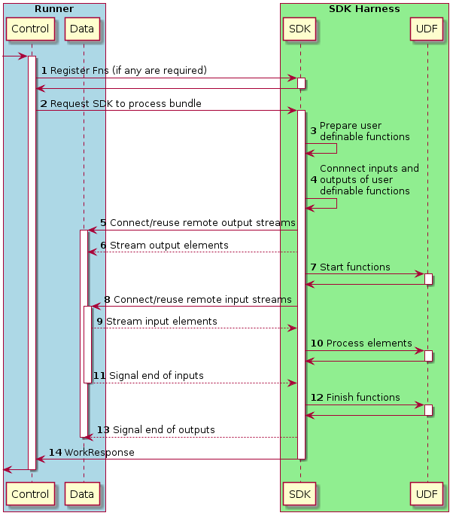
Fn API - Bundle Processing
Bundle size matters!
Amortize overhead over many elements
Watermark hold effect on latency
https://s.apache.org/beam-fn-api-processing-a-bundle

Slide 28

Lyft Flink Runner Customizations
Translator extension for streaming sources
Kinesis, Kafka consumers that we also use in Java Flink jobs
Message decoding, watermarks
Python execution environment for SDK workers
Tailored to internal deployment tooling
Docker-free, frozen virtual envs
https://github.com/lyft/beam/tree/release-2.11.0-lyft

Slide 29

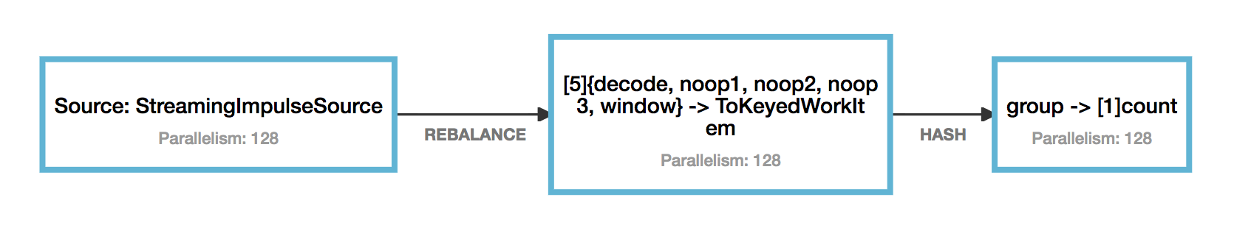
How slow is this ?
Fn API
decode, …, window
count
(messages
| 'reshuffle' >> beam.Reshuffle()
| 'decode' >> beam.Map(lambda x: (__import__('random').randint(0, 511), 1))
| 'noop1' >> beam.Map(lambda x : x)
| 'noop2' >> beam.Map(lambda x : x)
| 'noop3' >> beam.Map(lambda x : x)
| 'window' >> beam.WindowInto(window.GlobalWindows(),
trigger=Repeatedly(AfterProcessingTime(5 * 1000)),
accumulation_mode= AccumulationMode.DISCARDING)
| 'group' >> beam.GroupByKey()
| 'count' >> beam.Map(count)
)
Fn API Overhead 15% ?
Fused stages
Bundle size
Parallel SDK workers
TODO: Cython, protobuf C++ bindings

Slide 30
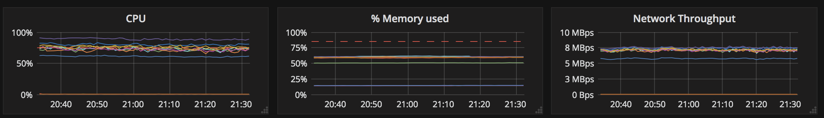
Fast enough for real Python work !
c5.4xlarge machines (16 vCPU, 32 GB)
16 SDK workers / machine
1000 ms or 1000 records / bundle
280,000 transforms / second / machine (~ 17,500 per worker)
Python user code will be gating factor

Slide 31
Beam Portability Recap
Pipelines written in non-JVM languages on JVM runners
Python, Go on Flink (and others)
Full isolation of user code
Native CPython execution w/o library restrictions
Configurable SDK worker execution
Docker, Process, Embedded, ...
Multiple languages in a single pipeline (future)
Use Java Beam IO with Python
Use TFX with Java
<your use case here>

Slide 32
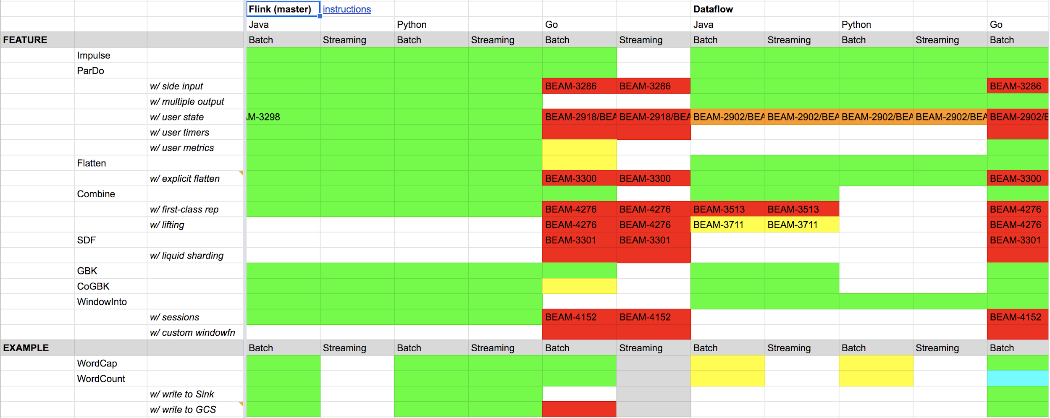
Feature Support Matrix (Beam 2.11.0)
https://s.apache.org/apache-beam-portability-support-table

Slide 33
Lessons Learned

Slide 34
Lessons Learned
Python Beam SDK and portable Flink runner evolving
Keep pipeline simple - Flink tasks / shuffles are not free
Stateful processing is essential for complex logic
Model execution latency matters
Instrument everything for monitoring
Approach for pipeline upgrade and restart
Mind your dependencies - rate limit API calls
Testing story (integration, staging)
Notes:
Beam is New
Notes on 'work in progress': (alpha) Issues may exist-- e.g. reshuffling losing events, memory leaks, cancel causes exception. But they are usually resolved quickly!
Shuffle is not free
shuffle = group by key or cogroupbykey or combine or reshuffle
each taskmanager has a fixed amount of network buffer memory (% of total jvm) and the usage of network buffer mem scales quadratically w/ number of shuffles
anything that distributes work and requires sharding and sending over the wire
shuffles not only add latency because of network calls, they also take up network buffer space which is a % of total memory
We had to rewrite a lot when we realized GroupByKey and other reshuffles ops incurred significant cost in terms of latency and memory
There were memory leaks on both beam side and our side (via pandas dataframes for instance)
event time vs processing time - ??
staging env -
need to figure out how it should work, rollout is all or nothing....
We had some stuff out of the box -- iterator age for kinesis, memory and cpu stats-- but it was crucial to have detailed statsd logging on intermediate features at all stages-- segmented by region etc
This is obvious and yet we still had to go back and put in some stats that were overlooked. e.g. early on we noticed demand output from old system declining over time relative to new. diagnosing and debugging got us to a point where we weren't even doing any transforms yet and still seeing problem. finally we added event counts per event type per region as a stat within our old system, and comparing to kinesis showed events were getting dropped. So instrument at every stage and make sure you have symmetrical data from old vs new system.
Similarly you want to count output at each intermediate stage...
Finally at the end of the day we still ended up using a lot of log stmts. You create a do method that just outputs the input and insert it into your pipeline. Can't get around log statements
Ratelimiter
It is really important to use the ratelimiter for your api calls for otherwise you can DDOS your services. Generally, it is not recommended to have service call in the api because it can cause bursty traffic and your service may not be able to handle the load. Having a ratelimiter in front of them can help to handle bursty traffic.
Testing Story
Load testing helped us to discover many performance issues before going to production. Beam community were very helpful and active to quickly fix these issues. it could have been a major problem if we have rolled out in production and noticed such issues.
Flink deploy is all or nothing, different from other web services
No canary
How do you handle downtime during deploy? (checkpointing? discard last window?)

Slide 35
We’re Hiring! Apply at www.lyft.com/careers
or email data-recruiting@lyft.com
Data Engineering
Data Infrastructure
Experimentation
Engineering Manager
San Francisco
Software Engineer
San Francisco, Seattle, & New York City
Engineering Manager
San Francisco
Software Engineer
San Francisco & Seattle
Software Engineer
San Francisco
Observability
Streaming
Software Engineer
San Francisco
Software Engineer
San Francisco
Notes:
***feel free to edit based on season;
No need to divide by location, can also divide by department

Slide 36




Please ask questions!
This presentation:
http://go.lyft.com/dynamic-pricing-strata-sf-2019

